Slide 1
Care of Drug Exposed Neonate
By: E. Bernard Cartaya, MD
Director of Neonatology
Manatee Memorial Hospital
BCartaya@aol.com

Slide 2
Care of Drug Exposed Neonate

Slide 3
Objectives:
Describe the common causes of NAS
Clinical Presentation
Diagnosis
Identify the different scoring system for pharmacologic therapy
Minimize neuroexcitation during withdrawal
Pharmacologic treatment
Prenatal counseling in setting of known exposure

Slide 4
Epidemiology
The CDC reports that currently 1 American dies every 14 minutes from drug overdose.
In Florida 7 people die every 24 hours due to prescription drug overdose

Slide 5
Epidemiology (cont.)
Unintentional poising (replacing automobile accidents) is the leading cause of death for ages 15-34.
The incidence of Neonatal Abstinence Syndrome (NAS) has increased 700% during the pasted 10 years.

Slide 6
Epidemiology (cont.)
The 2009 National Survey on Drug Use and Health noted that 4.5% of pregnant women 15 to 44 years of age reported recent use of illicit drugs (e.g., marijuana, cocaine, hallucinogens, heroin, methamphetamines, and nonmedical use of prescription drugs)

Slide 7
Mayor Drug of Abuse
Opioids | CNS Stimulants | CNS Depressants | Hallucinogens
Agonists | Amphetamines | Alcohol | Indolealkylamines (LSD, psilocin, psilocybin, DMT, DET)
Morphine | Dextroamphetamine (Dexedrine) | Barbiturates | Phenylethylamines (mescaline, peyote)
Codeine | Methamphetaine | Benzodiazepines | Phenylisopropylamines (MDA, MMDA, MDMA, MDEA)
Methadone | Amphetamine sulfate | Other sedative-hypnotics | Inhalants
Meperidine (Demerol) | Amphetamine congeners | Methaqualone (Quaalude | Solvents and aerosols (glues, gasoline, paint thinner, cleaning solutions, nail polish remover, Freon)
Oxycodone (Percodan, OxyIR, Percolone, Roxicodone, Percocet, OxyContin) | Benzphetamine (Didrex) | Glutethimide (Doriden) | Nitrites
Propoxyphene (Darvon) | Diethylpropion (Tenuate) | Chloral hydrate | Nitrous oxide Ref: http://pediatrics.aappublications.org/content/129/2/e540.full

Slide 8
Mayor Drug of Abuse (cont.)
Hydromorphone (Dilaudid) | Fenfluramine | Cannabinoids
Hydrocodone (Lortab, Vicodin) | Phendimetrazine (Adipost, Bontril, Prelu-2) | Marijuana
Fentanyl (Sublimaze) | Phentermine (Adipex-P, Zantryl) | Hashish
Tramadol (Ultram, Ultracet) | Cocaine
Heroin | Methylphenidate (Ritalin, Concerta)
Antagonists | Pemoline (Cylert)
Naloxone (Narcan) | Phenylpropanolamine
Naltrexone (ReVia) | Phencyclidines
Mixed Agonist-Antagonists | Nicotine
Pentazocine (Talwin)
Buprenorphine (Buprenex) |  | Ref: http://pediatrics.aappublications.org/content/129/2/e540.full

Slide 9
Mayor Drug of Abuse (cont.)
DET, diethyltryptamine; DMT, dimethyltryptamine; LSD, lysergic acid diethylamide; MDA, methylenedioxyamphetamine; MDEA, 3,4-methylenedioxyethamphetamine; MDMA, 3,4-methylenedioxymethamphetamine (ecstasy); and MMDA, 3-methoxy-4,5-methylenedioxyamphetamine
Ref: http://pediatrics.aappublications.org/content/129/2/e540.full

Slide 10
The Most Frequent Cause of NAS
Methadone
Morphine
Cocaine
Oxycodone
Codeine
Heroin
Bubprenorphine (Subutex)

Slide 11
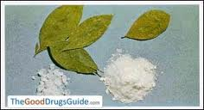
Drug Reported to Have Adverse Prenatal and Postnatal Effects
Cocaine:
- AKA: Blow, Bump, C, Candy, Charlie, Coke, Snow. This is a potent vasoconstrictor, causing tachycardia and increased circulating catecholamine
Effects:
1. IURG, low birth weight, decreased head circumference
2. Birth defects- cardiovascular and CNS (Cerebral palsy or stroke)
3. Placental abruption
4. Preterm birth
5. Fetal Death
6. Increased incidence of SIDS (4x)
http://www.marchofdimes.com/pregnancy/alcohol_illicitdrug.html
http://www.picc.net, http://abovetheinfluence.com/facts/drugscocaine

Slide 12
Drug Reported to Have Adverse Prenatal and Postnatal Effects
Cocaine NAS-Withdrawal is not as clearly defined as in opiates:
Maternal Withdrawal:
Apathy
Long periods of sleep
Irritability
Depression
Increased appetite
Neonatal Withdrawal:
Irritability
High pitched cry
Long periods of sleep
Excessive sucking
Increased appetite
Decreased appetite
http://www.marchofdimes.com/pregnancy/alcohol_illicitdrug.html
http://www.picc.net
http://abovetheinfluence.com/facts/drugscocaine

Slide 13
Drug Reported to Have Adverse Prenatal and Postnatal Effects
Marijuana / Cannabis: aka. Weed, Ganja, Balls, Purple, Nuts, Grape, Testicles, Pot, Tree, Wine, Grass, Green, Blunt
Effects: Fetal exposure to marijuana, the illicit drug most commonly used by pregnant women, does not cause clinically important neonatal withdrawal signs but may have subtle effects on long-term neurobehavioral outcomes. However, other authors feel that neonates experience symptoms similar to those seen in nicotine withdrawal.
Trembling
Difficulty with state regulation
Hypersensitive to stimulation
Long term effects- Poorly studied some suggest decrease ability to pay attention
4 Ampolongo P,Trezza V,Palmery M, Trabace L,Cuomo V. Developmental exposure to cannabinoids causes subtle and enduring neurofunctional alterations. Int Rev Neurobiol. 2009;85:117–133
http://www.marchofdimes.com/printableArticles/alcohol_illicitdrug.html

Slide 14
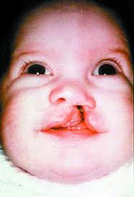
Drug Reported to Have Adverse Prenatal and Postnatal Effects
Caffeine and Nicotine:
Effects- Infants exposed to large amounts of caffeine and nicotine have been reported to exhibit withdrawal symptoms.
Trembling-Hyperirritability
Trouble coordinating suck and swallow
Nicotine-Well documented
- IUGR
- Cleft lip or palate
- Premature birth
http://www.marchofdimes.com/westvirginia/news_statehashighestrateofpregnantsmokers11.html

Slide 15
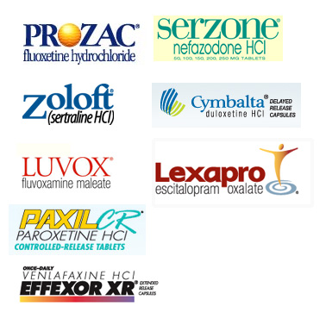
Drug Reported to Have Adverse Prenatal and Postnatal Effects
SSRI- Selective Serotonin reuptake inhibitors. (eg, fluoxetine [Prozac], paroxetine [Paxil], sertraline [Zoloft], citalopram [Celexa], escitalopram [Lexapro], and fluvoxamine [Luvox]) are now the most frequently used drugs to treat depression both in the general population and in pregnant women.
These are linked third-trimester use of SSRIs in pregnant women to a constellation of neonatal signs:
- crying
- irritability
- jitteriness, and/or restlessness
- shivering fever
- tremors
- hypertonia or rigidity
- tachypnea or respiratory distress
- feeding difficulty
- sleep disturbance
- hypoglycemia
- seizures
A recommendation for the lowest effective dose during pregnancy has been made.
Hudak M L et al. Pediatrics 2012;129:e540-e560
http://pediatrics.aappublications.org/content/129/2/e540.full
Addad PM,Pal BR,Clarke P, Wieck A, Sridhiran S. Neonatal symptoms following maternal paroxetine treatment: serotonin toxicity or paroxetine discontinuation syndrome? J Psychopharmacol. 2005;19(5):554–557

Slide 16
Drug Reported to Have Adverse Prenatal and Postnatal Effects
Opiate & Opioids:
Opiates – a natural narcotic alkaloid such as morphine or codeine found in poppies. Hydrocodone is a semi synthetic made from an opiate
Opioids – is a fully synthetic alkaloid such as Fentanyl. These compounds activate the u opiod receptors sites producing pain relief, sedation and euphoria. The majority of u receptors are found in the CNS and GI tract. After tolerance is established, the abstinence of opioids generate a exaggerated release of noradrenalin and causes withdrawal symptoms.
Medical Effects:
Pain relief
Cough suppression
Reduced gut motility
Secondary effects:
Itching
Euphoria
Sedation
Nausea
Chest pain

Slide 17
Drug Reported to Have Adverse Prenatal and Postnatal Effects
Opiate & Opioids:
Effects:
Addiction
Physical & Psychological
Occurs when the body depends on the drug to maintain homeostasis
Withdrawal Symptoms:
Nausea and vomiting
Diarrhea
Dilated pupils
Abdominal pain
Extreme anxiety
Extreme drug craving

Slide 18
Screening
Maternal:
Through maternal assessment and structured interview
Urine
Hair
Neonate:
Urine
Meconium
Hair
Cord blood (under research)

Slide 19
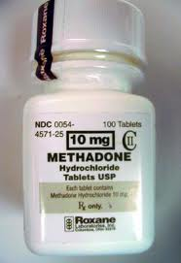
Treatment of Addicted Mothers
Methadone-synthetic opioid
Powerful analgesic with long half life and used for antiopioid dependence and management of chronic pain
Completely fills U-receptors
Does not give euphoria effect in large amounts

Slide 20
Treatment of Addicted Mothers
Methadone Treatment - 30 years experience
Advantages
Oral administration
Known dose and purity
Safe and steady availability
Not associated with birth defects
No association with preterm birth
It improves compliance with prenatal care
Methadone treatment weight against harmful social factor - minimizes illicit drug use, behavior associated with, and illegal activities

Slide 21
Treatment of Addicted Mothers
Methadone Treatment
Disadvantages:
Neonatal abstinence syndrome

Slide 22
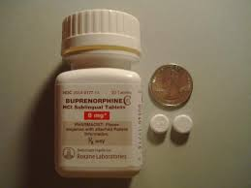
Treatment of Addicted Mothers
Buprenorphine (Subutex)
Does not totally cover u receptors site but displaced opiod
Fair sub lingual bioavailability
Poor GI bioavailability
http://www.samhsa.gov/

Slide 23
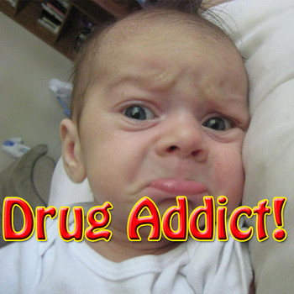
Neonatal Abstinence Syndrome (NAS)
Definition:
A generalized disorder presenting a clinical picture of central nervous system (CNS) hyperirritability, gastrointestinal (GI), dysfunction, respiratory distress, and vague autonomic symptoms

Slide 24
Neonatal Abstinence Syndrome (NAS)
Clinical Features of the Neonatal Narcortic Abstinence Syndrome⁷
Neurologic Excitability | Gastrointestinal Dysfunction
Tremors Irritability Increased wakefulness High-pitched crying Increased muscle tone Hyperactive deep tendon reflexes Exaggerated Moro reflex Seizures Frequent yawning and sneezing | Poor feeding Uncoordinated and constant sucking Vomiting Diarrhea Dehydration Poor weight gain Autonomic signs: Increased sweating Nasal stuffiness Fever Mottling Temperature instability

Slide 25
Neonatal Abstinence Syndrome (NAS)
Onset of symptoms:
Methadone 24-72 hours (up to 7 days)
Heroin 24 hours
Opiates birth-14 days
Cocaine about 1 week
Ethanol 3-12 hours
Buprenorphine 24-72 hours
Other factor involved are:
Gestational age, quantity of drug, frequency of use, duration of intrauterine exposure, timing of the last dose prior to delivery and maternal and infants metabolism

Slide 26
Neonatal Abstinence Syndrome (NAS)
Neonatal Opioid Withdrawal:
Neonatal abstinence Syndrome (NAS) occurs in 50-95% of infants parentally exposed
Onset is usually within 48-72 hours (but can 4 weeks later)occur up to 4 weeks
Infants at risk for NAS should be carefully monitored in the hospital for the development of signs consistent with withdrawal.
The appropriate duration of hospital observation is variable and depends on the maternal drug history. hydrocodone; (average half-life, 4 hours) may be safely discharged if there are no signs of withdrawal by 3 days of age, whereas an infant born to a mother on an opiate with a prolonged half-life (ex. methadone) should be observed for a minimum of 5 to 7 days.
Initial treatment of infants who develop early signs of withdrawal is directed at minimizing environmental stimuli (both light and sound) by placing the infant in a dark, quiet environment; avoiding auto stimulation by careful swaddling; responding early to an infant’s signals; adopting appropriate infant positioning and comforting techniques (swaying, rocking)

Slide 27
Neonatal Abstinence Syndrome (NAS)
Providing frequent small volumes of hyper caloric formula or human milk to minimize hunger and allow for adequate growth. Caloric needs may be as high as 150 to 250 cal/kg per day because of increased energy expenditure and loss of calories from regurgitation, vomiting, and/or loose stools.
Maternal screening for comorbidities, such as HIV or hepatitis C virus infections and polydrug abuse, needs to be performed.
Additional supportive care in the form of intravenous fluids, replacement electrolytes, and gavage feedings may be necessary to stabilize the infant’s condition in the acute phase and obviate the need for pharmacologic intervention.

Slide 28
Neonatal Abstinence Syndrome (NAS)
When possible, and if not otherwise contraindicated, mothers who adhere to a supervised drug treatment program should be encouraged to breastfeed so long as the infant continues to gain weight. Breastfeeding or the feeding of human milk has been associated with less severe NAS that presents later and less frequently requires pharmacologic intervention.
There is no clear reason to discourage breastfeeding in mothers who adhere to methadone or buprenorphine maintenance treatment. An Australian study demonstrated that breast milk fed group exhibited lower NAS scores and required less treatment than the control group.
Abdel-Latif ME, Pinner J, Clews S, Cooke F, Lui K,Oei J. Effects of breast milk on the severity and outcome of neonatal abstinence syndrome among infants of drug-dependent mothers. Pediatrics. 2006;117(6). Available at: www.pediatrics.org/cgi/content/full/117/6/e1163pmid:16740817
Jansson LM, Academy of Breastfeeding Medicine Protocol Committee . ABM clinical protocol #21: guidelines for breastfeeding and the drug-dependent woman. Breastfeed Med. 2009;4(4):225–14 28pmid:19835481
14. Mohamed E. Abdel-Latif, MRCPCH,
Effects of Breast Milk on the Severity and Outcome of Neonatal Abstinence Syndrome Among Infants of Drug-Dependent Mothers; Pediatrics 2006

Slide 29
Neonatal Abstinence Syndrome (NAS)
Scoring Tools:
65% Finnigan/Mod. Finergan
4% Lipsitz
14% Unit developed scales
18% No scoring system

Slide 30
Signs and Symptoms

Slide 31
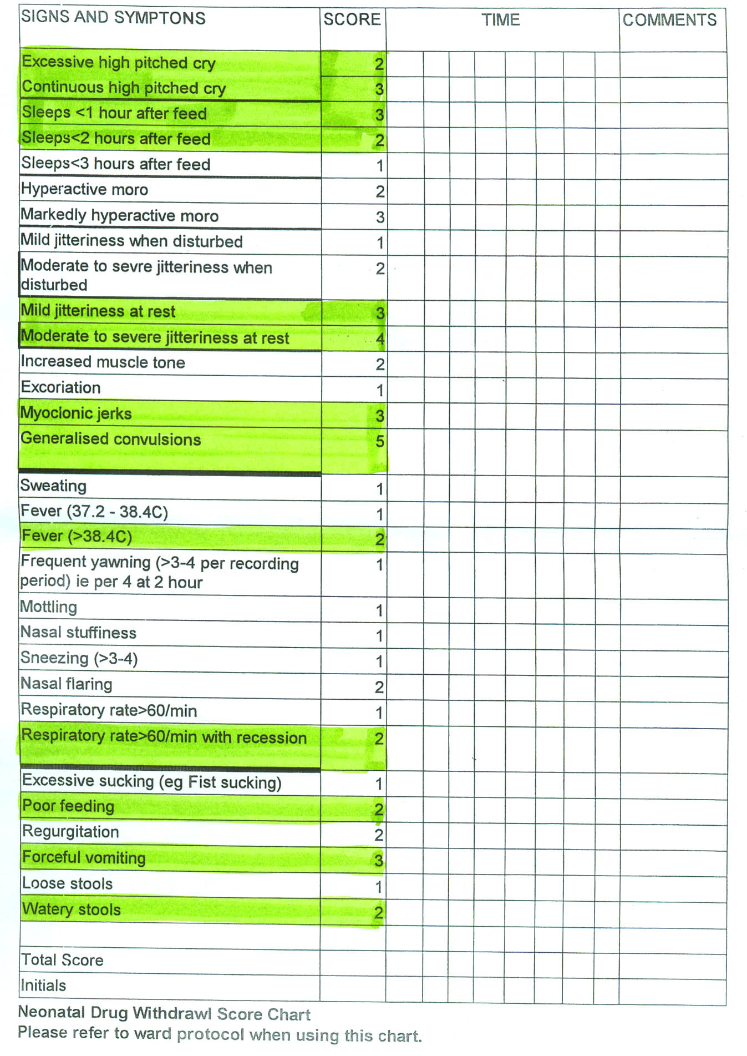
Finnegan Score

Slide 32
Treatment
Non Pharmacological:
Swaddling
Minimal stimulation, quiet atmosphere
Low lighting
Rocking
Pacifier
Hold infant is “C” position
Firm clapping of bottom

Slide 33
Treatment
Pharmacological Treatment
Drugs Used in the Treatment of Neonatal Narcotic Withdrawal
Oral Phenobarbital 10 mg/kg every 12 PRN (adjunct therapy most MD)
Drug | Initial Dose | Increment | Maximum Dose
Oral morphine | 0.04 mg/kg every 3–4 h | 0.04 mg/kg per dose | 0.2 mg/kg per dose
Oral methadone | 0.05–0.1 mg/kg every 6 h | 0.05 mg/kg per dose | To effect
Oral clonidine | 0.5–1 µg/kg every 3–6 h | Not studied | 1 µg/kg every 3 h

Slide 34
References
http://pediatrics.aappublications.org/content/129/2/e540.full
http://www.marchofdimes.com/pregnancy/alcohol_illicitdrug.html
http://www.picc.net, http://abovetheinfluence.com/facts/drugscocaine
4 Ampolongo P,Trezza V,Palmery M, Trabace L,Cuomo V. Developmental exposure to cannabinoids causes subtle and enduring neurofunctional alterations. Int Rev Neurobiol. 2009;85:117–133
http://www.marchofdimes.com/printableArticles/alcohol_illicitdrug.html
http://www.marchofdimes.com/westvirginia/news_statehashighestrateofpregnantsmokers11.html
Hudak M L et al. Pediatrics 2012;129:e540-e560
http://pediatrics.aappublications.org/content/129/2/e540.full
Addad PM,Pal BR,Clarke P, Wieck A, Sridhiran S. Neonatal symptoms following maternal paroxetine treatment: serotonin toxicity or paroxetine discontinuation syndrome? J Psychopharmacol. 2005;19(5):554–557
http://www.samhsa.gov/
Kandall SR, Gartner LM. Late presentation of drug withdrawal symptoms in newborns. Am J Dis Child. 1974;127(1):58–61
11. Hill RM,Desmond MM. Management of the narcotic withdrawal syndrome in the neonate. Pediatr Clin North Am. 1963;10:67–86pmid:13954547
Abdel-Latif ME, Pinner J, Clews S, Cooke F, Lui K,Oei J. Effects of breast milk on the severity and outcome of neonatal abstinence syndrome among infants of drug-dependent mothers. Pediatrics. 2006;117(6). Available at: www.pediatrics.org/cgi/content/full/117/6/e1163pmid:16740817
Jansson LM, Academy of Breastfeeding Medicine Protocol Committee . ABM clinical protocol #21: guidelines for breastfeeding and the drug-dependent woman. Breastfeed Med. 2009;4(4):225–228pmid:19835481
14. Mohamed E. Abdel-Latif, MRCPCH
Effects of Breast Milk on the Severity and Outcome of Neonatal Abstinence Syndrome Among Infants of Drug-Dependent Mothers; Pediatrics 2006

Slide 35
Thank You

