Slide 1


Pause. Prevent. Protect.
Get with the Guidelines

Slide 2
Program Contents
Introduction to GSAHEC
AHEC Tobacco Training and Cessation Services
Tobacco Use Prevalence
How Can You Help?
Tobacco Dependence
Tobacco Use Health Effects
Forms of Tobacco
Nicotine
    Properties
    Amount in Tobacco Products
    Effects
    Addiction
Treating Tobacco Use Dependence
Benefits of Quitting
PHS Clinical Practice Guidelines
Tobacco-User Identification Systems
5 A’s & 2A’s and an R
Motivational Interviewing
Stages of Change
Readiness Ruler
NRT
    Types
    Insurance Coverage
Coverage of Tobacco Cessation Counseling
GSAHEC Cessation Services
Questions

Slide 3




GSAHEC was established in 1995 to address the needs of medically underserved populations of Charlotte, DeSoto, Manatee and Sarasota counties.
Is affiliated with the University of South Florida
College of Medicine AHEC Program.
Is one of ten (10) AHEC Centers in Florida
and part of the Florida AHEC Network
Is an active member of the National AHEC Organization (NAO).

Slide 4

Tobacco Training and
Cessation Services
Training for health professions students and health care providers
Free tobacco cessation services utilizing a 6-week support group or a 2 -hour seminar
Limited free NRT
Free tobacco cessation phone counseling
Limited free NRT
Online Program
For help with tobacco cessation log onto:
www.quitnow.net/florida

Slide 5
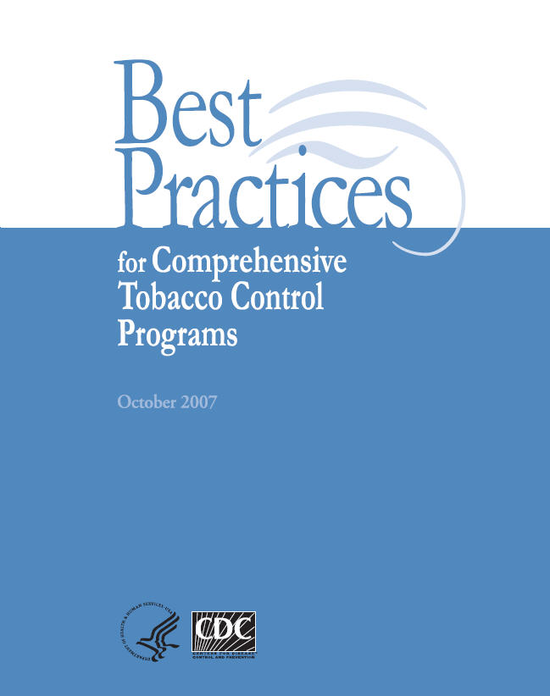
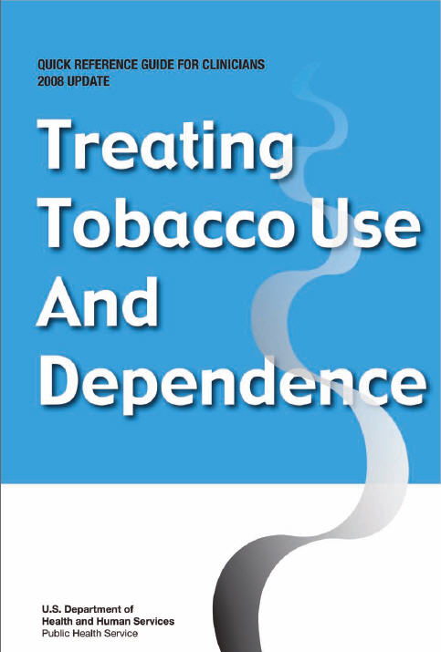
GSAHEC Services Are Based On:
CDC Best Practices
Public Health Service Guidelines

Slide 6
Compliance
Resolution 411 of the American Medical Association
Family Smoking Prevention and Tobacco Control Act June 2009
States that information and materials provided to patients and consumers should come from credible and trustworthy sources with expertise in tobacco control and not from tobacco companies or other groups aligned with the tobacco industry.
Authority to regulate the
manufacturing, marketing and
sale of tobacco products to
protect America’s health
particularly, the children and
adolescents from the dangers of
tobacco use. (Advertising, Labeling, Flavoring, Chemical constituents, Nicotine, New product rule)

Slide 7
Tobacco Use Prevalence
44.3% of all cigarettes smoked in USA are consumed by people with mental illness
443,000 annual deaths in USA related to tobacco use
6.5%-15.9% of youth aged 12-17 years smoke in USA
Costs $193 billion in health care expenditures and productivity losses annually in USA
17.5% of Florida adults smoke
6.7% of Floridians use smokeless tobacco
28,607 annual deaths in Florida directly caused by smoking
Costs $13.2 billion in health care expenditures and productivity losses in Florida

Slide 8
How Can You Help?
Provider involvement can help 720,000 smokers become nonsmokers every year
70% of smokers visit health clinics annually, 30–50% visit dental clinics
70% of smokers want to quit but less than 5% can do it by themselves
A brief intervention by a health care provider can improve success rate by a minimum of 10%
Smokers cite a provider’s advice to quit as an important motivator for attempting to quit smoking
Brief interventions by all clinicians of less than 3-10 minutes can make a difference!

Slide 9

Tobacco Dependence
Is a chronic disease
Often requires repeated interventions and multiple attempts to quit
Patients may have periods of relapse and remission
Is akin to other chronic disorders such as diabetes, hypertension, and hyperlipidemia

Slide 10
Health Effects
Tobacco use is the single greatest cause of preventable disease and premature death in the United States
Tobacco chemicals and smoke affects all cells, tissues and organs and have been linked to at least 25 diseases.
Respiratory Problems
COPD –Chronic Obstructive Pulmonary Disease
Emphysema and Chronic Bronchitis
Vascular Problems
Coronary Hearth Disease
Peripheral Vascular Disease and Stroke
Cancers
Lung. esophageal, pancreatic, mouth & throat
Poor Birth Outcomes
Premature birth, low birth weight and up to 10% of all infant deaths

Slide 11
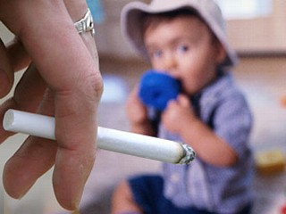
Second- and Third-
Hand Smoke
Secondhand Smoke (SHS) is the combination of two forms of smoke from burning tobacco products:
Side-stream smoke – smoke emitted from a burning cigarette, pipe or cigar
Main-stream smoke – smoke exhaled by the smoker
Third-Hand Smoke (THS) – tobacco smoke contamination remaining after the cigarette has been put out
The toxins that linger in clothes, hair, hands, carpets, sofas, draperies, vehicles and other places hours or even days after a cigarette is put out

Slide 12
Special Populations

Slide 13
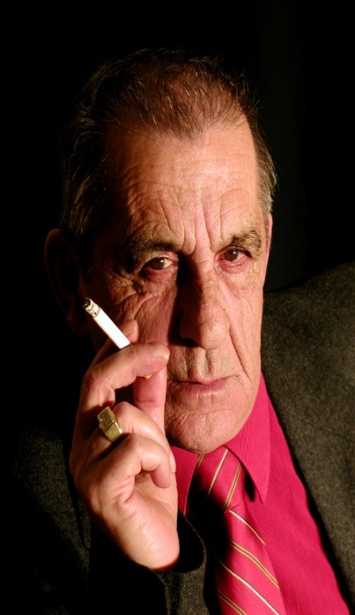
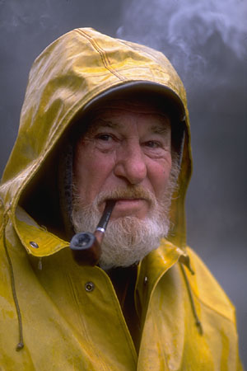




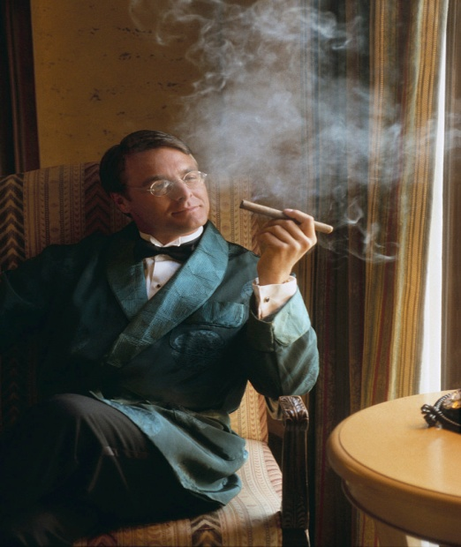
So Why are People Still Using it?
Tobacco Kills

Slide 14
Forms of Tobacco
Smoking Tobacco
Cigarettes (10 mgs of nicotine/each)
Cigars (equal to 1.5 packs of cigarettes)
Pipes
Bidis
Cloves
Hookah
E-cigarette
Smokeless Tobacco
Chewing Tobacco (1 can = 3 packs of cigarettes)
Moist Snuff (aka spit or “dip”)
Moist Snus
Dissolvable Products
    Tablets
    Sticks
    Strips
    Candy flavored

Slide 15
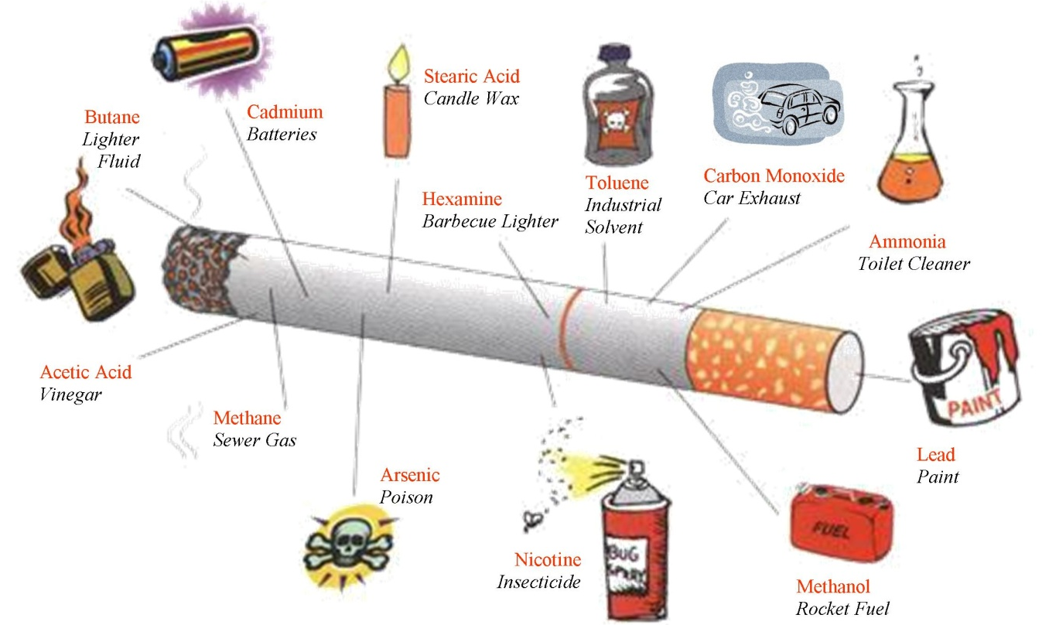
Over 7,000 Chemicals
(70 Carcinogens)
Tobacco leaf
  Natural, cultivation and curing process
Additives
  By tobacco companies
Paper and filter
  Fibers inhaled
Pyrolysis
  Combustion

Slide 16
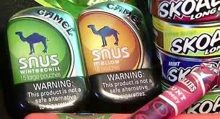
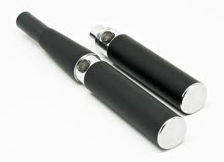
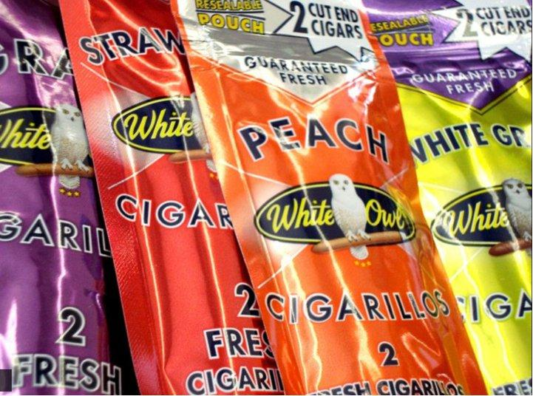
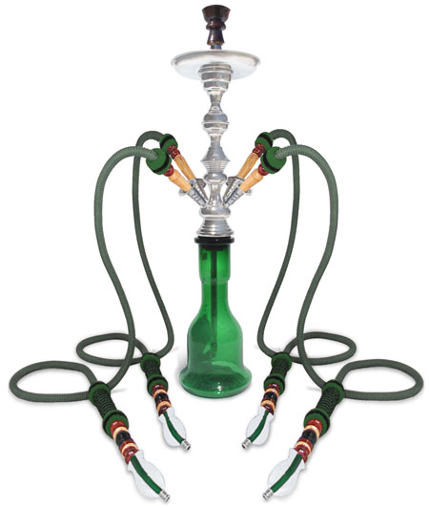
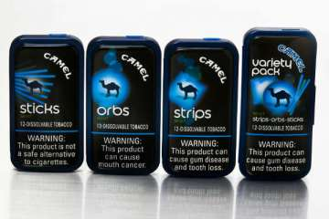



Slide 17

Nicotine
According to the American Medical Association nicotine is toxic and addictive
Drop for drop more lethal than strychnine, rattlesnake venom, and deadlier than arsenic
A psychoactive drug that activates receptors in the reward center of the brain
Increases heart rate, blood pressure, pulse, vasoconstriction and cholesterol levels.
Causes glucose release, higher blood sugar levels
http://www.pharma.unibas.ch
Notes:
Nicotine does not cause lung cancer, nicotine causes addiction

Slide 18
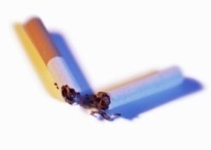
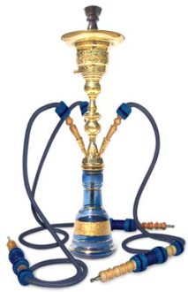

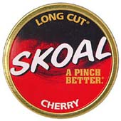
Amounts of Nicotine
1 cigarette has 10 mgs. of nicotine
1 cigar equals
1 ½ packs of cigarettes
1 can of smokeless tobacco equals
about 3 packs of cigarettes.
1-hour session of Hookah equals 100 cigarettes

Slide 19
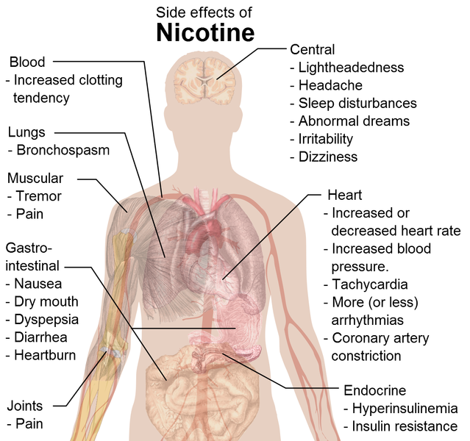
Nicotine Effects

Slide 20

Nicotine Addiction Cycle
Nicotine Blood Level Falls
Brain Generates Crave
Inhale New Nicotine
Brain Releases Dopamine
Cycles Starts Again

Slide 21
After a While
Tolerance
Dependence
The brain adapts to the surges in dopamine by producing less dopamine or by reducing the number of dopamine receptors.
The decrease in dopamine compels the person to keep abusing the nicotine in order to normalize their dopamine function.
However, they may now require larger amounts of nicotine than they first did to achieve the “dopamine high”.
Addiction to drugs causes changes in critical areas of the brain that affect judgment, decision making, learning, memory, and behavior control.
The abuser continues to seek out and take drugs compulsively, despite adverse consequences.
The person “functions normally” in the presence of the drug, and if the drug is removed, physical and mental disturbances are manifested.

Slide 22
Measuring Nicotine Dependence
Fagerstrom Scale (originally 6 questions)
Have been shortened to two questions to assess heaviness of smoking index:
1. Number of cigarettes smoked per day?
2. Time of first cigarette (AM)?
♦ ≤ 5 minutes=severe
♦ ≤ 30 minutes=moderate
Important for treatment, including what type of nicotine replacement therapies (NRT) to recommend and how much to use.

Slide 23
Treating Nicotine Dependence
Assessment
Treatment
Level of Dependence
Motivation to quit
First age smoked
Years smoked
Current amount
Types of tobacco used
Smokers in household
Health/other consequences
Must target physical, psychological and behavioral aspects of addiction
Appropriate use of NRT almost doubles success rates
Individuals with mental health disorders are at greater risk for nicotine addiction

Slide 24
Nicotine Withdrawal Symptoms
May Begin Shortly
After Last Cigarette
Peaks in Two (2) Days
and Subsides in 2-4 Weeks
Irritability
Difficulty in concentrating
Impatience
Hostility
Anxiety
Depressed mood
Insomnia
Restlessness
Decreased heart rate
Increased appetite or weight gain

Slide 25
Health Benefits of Quitting

Slide 26

How Can We Increase Quit Rates?
What does research show?

Slide 27
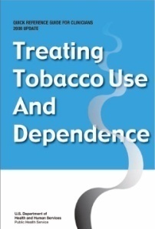
PHS Clinical Practice Guidelines
Institutionalize a system to identify tobacco users
at every visit.
Advise all who use tobacco to quit at every visit.
Use the 5 A’s, the 2 A’s and an R, or MI
(Motivational Interviewing) approaches.
Align tobacco counseling content to the patient’s “stage of change”.
Use effective Nicotine Replacement Therapy (NRT) medications in assisting clients; very few contraindications exist.
Provide counseling, or refer to GSAHEC or the Florida Quitline for cessation resources
Notes:
CME from Michael Fiore, lead author of the clinical practice guidelines. Also, more is more, more sessions, more time, dose response

Slide 28
Tobacco-User Reminder Systems
Screening System | Estimated rate of clinician intervention (95% C.I.)
No screening system in place to identify smoking status | 38.5
Screening system in place to identify smoking status | 65.6 (58.3-72.6)
*2008 CPG Treating Tobacco Use and Dependence Public Health Service

Slide 29
Paper Chart - Tobacco User Identification
  After the initial question, the provider could further initiate intervention with:
♦ ASK
♦ ADVISE
♦ REFER
VITAL SIGNS
BP: | Pulse:
RR: | Temp:
Weight: | Height:
Tobacco Use: Current Former Never
Form of Tobacco Used:
How often:
Did you advise patient to quit?
Referral:

Slide 30
Electronic Chart-Tobacco User Identification
  Automatically flags the provider to ask about patient’s tobacco status and usage at each visit.
  After identifying tobacco users, providers should be automatically directed to a window where they can further document for intervention purposes.
    ♦ 5 A’s, or
    ♦ 2 A’s & R

Slide 31
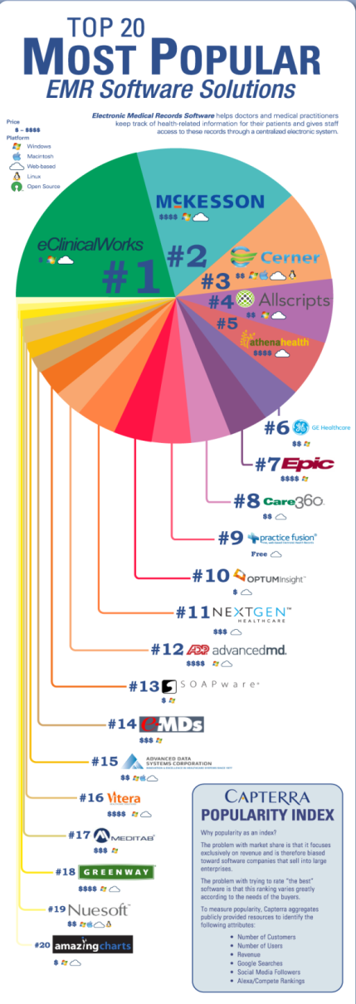
About Electronic Records
Electronic Medical Record (EMR) systems allow for patient information to be shared across one healthcare organization
Electronic Health Record (EHR) systems allow for patient information to be shared across multiple organizations
The American Recovery And Reinvestment Act of 2009 (ARRA) allocated $19.2 billion for those who adopt EHR for health information technology over the next five years
Eligible professionals (EPs) and hospitals that have not yet adopted EHR will be penalized in 2015

Slide 32
Meaningful EHR Tobacco-User Identification Systems
Must record smoking status of patients 13 years or older
Must enable user to record, modify, or retrieve smoking status of a patient
Smoking status must include:
  Current every day smoker
  Current some day smoker
  Former smoker
  Never smoked
  Smoker, current status unknown
  Unknown if ever smoked

Slide 33
5 A’s of Tobacco Intervention
1) Ask if they smoke
  At every visit
  Chart the answer
2) Advise them to quit
  Health care providers have a great impact on their patients
3) Assess their readiness
  If ready, go to step 4
  Or refer them to a specialist
  Remain available
  Those not ready should receive Motivational Interviewing (MI)
4) Assist them in quitting
  Quit date
  Quit plan
  NRT or smoking cessation drug
  Behavioral therapy
  Support groups
5) Arrange follow up
  Call
  Reassess
  Reassure

Slide 34
The 2 A’s and an R
A Modified Tobacco Intervention
ASK about tobacco use
  At every visit and chart the answer
ADVISE to quit
  Health care providers have a great impact on their patients
REFER to internal or external service who will complete the process.
Notes:
This is to let you know that some have abbreviated the 5 As, but it is not an official recommendation of the PHS or the QuitTeam

Slide 35
Health Care Provider Referral Rates
Most health care providers ask about tobacco usage and advise against it, but up to only 23% make the arrangements to help their patients quit.
From Elisa Tong, MD; Richard Strouse, BA; John Hall, JD, MS; Martha Kovac, MPH, and Steven Schroeder, MD. “National Survey of U.S. Health Professionals’ smoking prevalence, cessation practices, and beliefs” Nicotine and Tobacco Research Vol 12, N 7

Slide 36
Guiding Principles of
Motivational Interviewing (MI)
Express empathy - by using reflective listening
Develop discrepancy - by exploring pros and cons of a current behavior patient voices own argument for change
Roll with resistance by avoiding confrontation or arguing
Support self-efficacy by conveying faith in client’s ability to change and choosing interventions consistent with client preferences, goals, and values

Slide 37

Stages of Change Theory
A theoretical model of behavioral change developed by psychological theorists Prochaska, DiClemente and Norcross
Pre-contemplation
Contemplation
Preparation
Action
Maintenance

Slide 38
Recommended Strategies for
Each Stage of Change
Stage | Strategy
Pre-contemplation | Provide information
Contemplation | Identify discrepancy between goal and behavior, elicit self-motivational statements
Preparation | Plan strategies for change
Action | Identify and manage barriers
Maintenance | Stabilize change
Relapse | Identify relapse when it occurs, revisit self-efficacy and commitment

Slide 39
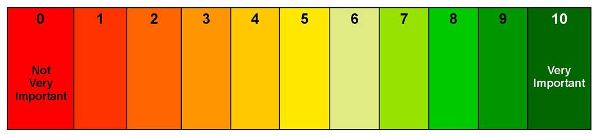
Readiness Ruler (“I May”)
Not
Very
Important
Very
Important
On a scale from 0-10, how important to you is quitting smoking?
Why do you think you are at ___ and not 0?
How do we get you to move from a ____ to a ____?
Notes:
ADDED

Slide 40
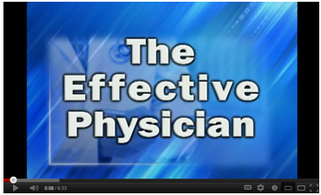
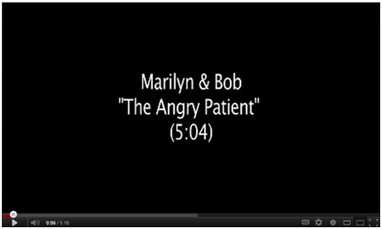
Motivational Interviewing in Action
Notes:
ADDED

Slide 41

How Much is Enough?
MI can be effective in a very short period of time
3-15 minutes
The more times you do it, the greater the effect.
Notes:
ADDED
Talk About Group Educational Sessions

Slide 42

OK, I’m Ready to Quit,
but I Need Help!
Notes:
ADDED

Slide 43
It works! It almost doubles success rates. There is evidence that combined forms of NRT are more effective than a single agent.
Helps patient feel more comfortable through the withdrawal phase.
NRT is very safe. The patient isn’t getting a new drug (nicotine), just the same drug at a lower dose, in a less addictive form, over a relatively short period of time.
“NRT will…increase the chance of success with any quit attempt but is most effective when combined with intensive behavioral support.”
(Molyneux, BMJ 2004; 328:454-456)
Why Use
Nicotine
Replacement
Therapy
(NRT)?

Slide 44
NRT

Slide 45
Options
NRT
Nicotine Gum (Over the counter)
Nicotine Inhaler (Prescription)
Nicotine Lozenges (Over the counter)
Nicotine Nasal Spray (Prescription)
Nicotine Patch (Over the counter)
Non NRT
Bupropion SR (Prescription)
Varenicline (Prescription)

Slide 46
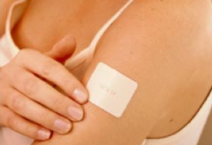
Over-The-Counter (OTC) Nicotine
Replacement Therapies
Nicotine Patch (21 mg.,14mg or 7mg)
Dispense one month supply. Replace patch daily. Refill 3 times.
Nicotine Gum (4 mg. or 2 mg.)
Dispense one month supply. Chew up to 20 pieces a day if by itself, 8-10 pieces if with the patch. Refill 3 times.
NRT should be reduced gradually as the number of tobacco free days increases.
Nicotine Lozenges (4 mg. or 2 mg.)
Dispense one month supply. Use up to 20 times a day if by itself, 8-10 times a day if with the patch. Refill 3 times.

Slide 47
OTC NRT Insurance Coverage
Covered by Medicaid only if written as a Rx at participating pharmacies (i.e. Walgreens)
  Medication coverage varies by plan
  Patients can ask preferred pharmacy for details
Medicare DOES NOT cover any OTC NRT
Private insurance coverage varies
GSAHEC offers limited, free NRT to cessation class participants
Florida Quitline can also assist with limited NRT

Slide 48
Contraindications for NRT
Certain medical conditions such as recent myocardial infarction (MI), arrhythmia, and current pregnancy require more caution and consultation with the health care provider
Some patients may have problems with certain products (e.g. allergy to patch)
Questionable efficacy for those who smoke less than 10 cigarettes per day and not recommended for those who smoke less than 5 per day

Slide 49
Other Methods
The following are not supported by current evidence or research:
  Hypnosis
  Acupuncture
  Anticholinergic shots
  Laser therapy
  E-cigarette
Notes:
E-Cigarettes

Slide 50
Tobacco Intervention Counseling Coverage
Affordable Care Act
Medicare will cover cessation counseling as a preventive service (outpatient and inpatient):
Current ICD-9 Billing Codes:
CPT 99406 -- Intermediate 3-10 minutes $12.89
CPT 99407 -- Intensive ↑ 10 minutes $24.83
ICD-9 – International Classification of Disease Book 9 - used by medical facilities for diagnosis coding
CPT – Current Procedural Terminology - codes to report medical services and procedures done by physicians
Rates not scheduled to change when ICD-10 takes effect October 1st, 2013

Slide 51
Medicare Reimbursement Rates
3–10 Minute Intervention at $12.89
Provider Income | 2 patients / day | 4 patients / day | 10 patients / day
Daily | $25.78 | $51.56 | $128.90
Monthly | $515.60 | $1,031.20 | $2,578.00
Yearly | $5,929.40 | $11,858.80 | $29,647.00
*Based on 20 work days/month, 2 weeks of vacation per year
**Physician’s Assistants, Nurse Practitioners, and Certified Nurse Specialists will receive 80% of stated benefit
Notes:
According to the 2011 Physician Fact Sheet, 75% of physicians see between 50-150+ patients per week (10-30 per day). According to the national average, 20.8% of these patients are likely to use tobacco. A higher percent is likely in pulmonary, oncology, pain management, and drug rehabilitation specialties.

Slide 52
Medicare Reimbursement Rates
10 + Minute Intervention at $24.83
Provider Income | 2 patients / day | 4 patients / day | 10 patients / day
Daily | $49.66 | $99.32 | $248.30
Monthly | $993.20 | $1,986.40 | $4,966.00
Yearly | $11,421.80 | $22,843.60 | $57,109.00
*Based on 20 work days/month, 2 weeks of vacation per year
**Physician’s Assistants, Nurse Practitioners, and Certified Nurse Specialists will receive 80% of stated benefit
Notes:
According to the 2011 Physician Fact Sheet, 75% of physicians see between 50-150+ patients per week (10-30 per day). According to the national average, 20.8% of these patients are likely to use tobacco. A higher percent is likely in pulmonary, oncology, pain management, and drug rehabilitation specialties.

Slide 53
Private Insurance Reimbursement
Florida does not mandate cessation counseling coverage for private insurance plans.
When plans do cover counseling, physicians can bill for it using the ICD-9 code for tobacco dependence, 305.1 (tobacco abuse).
Include the appropriate CPT code for preventive medicine and counseling, and risk factor reduction interventions services codes # 99401-99404. Not to be used for patients with symptoms of established illness.
Prescription drug coverage varies according to plan.
Generally, insurance companies may reimburse at Medicare rates, if not higher.
Note: Reimbursement is dependent upon the patient’s plan and the contract with the insurance company.
Notes:
Local medical billers indicate that because Medicare reimburses for tobacco cessation counseling, private insurance companies are likely to reimburse for it also. You can always call the insurer to inquire if tobacco cessation counseling will be reimbursed. If you’d rather not make the time to call to find out the exact reimbursement rate, billers suggest coding and billing for tobacco cessation at a rate 160-180% of the Medicare rates given previously in this presentation.

Slide 54
GSAHEC Tobacco Cessation Services
Referral and Assessment
Education on Five (5) Core Essentials:
  Dangers of tobacco use
  Benefits of quitting
  Challenges of quitting
  Aids for quitting
  Support for quitting
Free limited NRT for program participants
Provided by Tobacco Cessation Specialists and trained facilitators
Quit Smoking Now – a six (6) class format
Tools to Quit – a two (2) - hour seminar
Supportive Follow up
Relapse Prevention
Notes:
54

Slide 55

How can YOU make a difference?
It’s simple and Only Takes Three (3) Minutes!
  ASK and ADVISE
  REFER to GSAHEC
  GSAHEC will follow-up with your patients
Implement/modify and utilize tobacco-user identification systems
Educate all staff to ask and document patient's current and former tobacco status
Connect patient to GSAHEC and Florida Quitline for cessation resources

Slide 56


1-877-848-6696
www.gsahec.org

